Slide 1
© 2018 Cengage Learning®. May not be scanned, copied or duplicated, or posted to a publicly accessible website, in whole or in part.

Slide 2
Products: Goods and Services
6
© 2018 Cengage Learning.® May not be scanned, copied or duplicated, or posted to a publicly accessible website, in whole or in part.

Slide 3
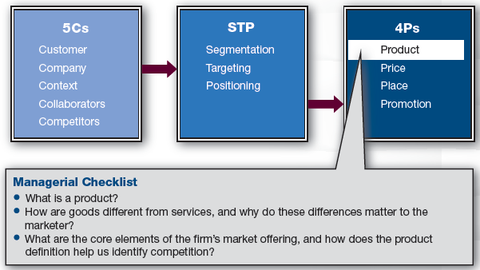
Marketing Framework
3

Slide 4
Discussion Questions #1
Is Arnold Schwarzenegger a product?
What is a product?

Slide 5
Products
A product can be either a good or a service
It is the most essential decision in the 4Ps because it is what the consumer is receiving in the exchange

Slide 6
Marketing Exchange (slide 1 of 2)
Exchange
The company offers something (product) that will benefit the customer
The product can be designed to be more or less attractive
Increase/decrease quality, service, etc.
The customer offers something in return (payment)
Customer can be more or less attractive
High/low loyalty, high/low maintenance, spreads positive word-of-mouth, etc.

Slide 7
Marketing Exchange (slide 2 of 2)
Marketers need to
Determine what the customers want in order to increase the likelihood of exchange
Determine what the company can profitably offer
The goal is to create mutually beneficial exchanges that result in long-term customer relationships

Slide 8
Discussion Questions #2
Discuss an example of a situation where a company is only looking for a discrete transaction with a customer.
Why do marketers want to create long-term relationships?

Slide 9
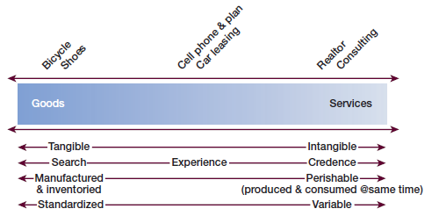
Goods vs. Services
Goods and services differ in terms of
Intangibility
Search, experience, credence
Perishability
Variability
9

Slide 10
Goods vs. Services: Intangibility
Intangibility:
Extent to which you have something concrete
Pure goods: e.g., paper & phone
Pure services: e.g., massage & babysitting
Hybrids: e.g., restaurant & beauty salon
Experience marketing
Consumers are buying the experience
e.g., ESPN Zone & Build-a-Bear

Slide 11
Goods vs. Services: Qualities (slide 1 of 2)
Search qualities
May be evaluated prior to purchase
Experience qualities
Need trial/consumption before evaluation
Credence qualities
Difficult to judge even post-consumption

Slide 12
Goods vs. Services: Qualities (slide 2 of 2)
Goods are dominated by search and experience qualities
Services are dominated by experience and credence qualities
Professional service providers are beginning to understand the value of marketing
Create professional appearance and setting, tap their networks, etc.

Slide 13
Goods vs. Services: Perishability
Perishability
Services are simultaneously produced and consumed; thus,
Services cannot be stored; goods can
Marketers need to even out demand
Services cannot be separated from the provider; goods can
Customer/service provider interaction becomes part of the service

Slide 14
Goods vs. Services: Variability
Variability
Goods are made by machines; services are usually people intensive
Services change across customers and across time
Marketers need to
Reduce bad variability
Enhance good variability
Self-service is advancing in many industries

Slide 15
Discussion Question #3
What steps can marketers take to reduce bad variability?

Slide 16
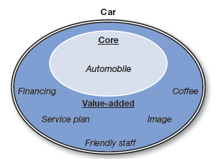
Core vs. Value-Added (slide 1 of 3)
Core is essential to the product offering
Value-added is supplemental
Can use to differentiate & improve satisfaction
Can use to identify competition
16

Slide 17
Core vs. Value-Added (slide 2 of 3)
Core elements are expected by customers
If core elements are substandard, dissatisfaction can be triggered
Recall issued, poor quality, etc.
Marketers can compete/differentiate on value-addeds
Generous service plan, good staff, etc.

Slide 18
Core vs. Value-Added (slide 3 of 3)
Core businesses may change as industries and firms change
e.g., Victoria’s Secret was 70% apparel but is now 70% beauty and fragrance
It is key to continually ask
What business are we really in?
Who are our true competitors?

Slide 19
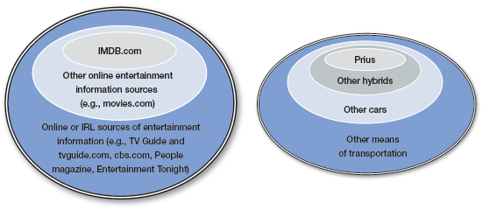
Competition through Customers’ Eyes
Define competition broadly
Car companies compete with other means of transportation (bus, taxi, etc.)
19

Slide 20
Product Lines: Breadth and Depth
Product mix
A company’s product lines
Breadth
Number of product lines
Frigidaire sells refrigerators, washers, dryers, ranges, etc.
Depth
Number of products in a line
Frigidaire refrigerators have different sizes and features

Slide 21
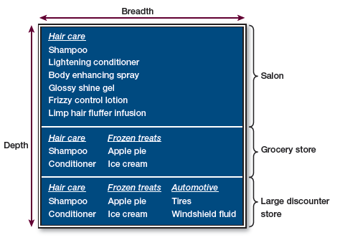
Discussion Questions #4
Which option has the least breadth?
Which option has the most depth?
21

Slide 22
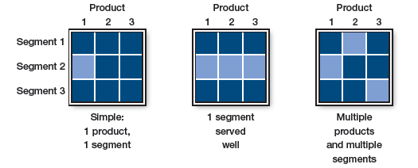
Product Line Strategies
Product line managers can prune or supplement existing lines
22

Slide 23
Discussion Questions #5
Which firm(s) above is leveraging its segment knowledge efficiently?
Inefficiently?
23

Slide 24
Managerial Recap (slide 1 of 2)
Products are goods and services
Products are the central offering in the marketing exchange
Goods and services share similarities and differences
Services are relatively more intangible, inseparable, perishable, and variable

Slide 25
Managerial Recap (slide 2 of 2)
A firm’s market offering is comprised of the core and the value-addeds
Consider competition broadly
Competition can evolve over time as product lines are further developed in length and breadth

